Slide 1


Introduction to
Robotic Process Automation
JEWELLERY
STOCK RETRIEVAL AND PRICE ESTIMATION
Your Register No. : 220701224
Name : RISHI BALA P
Guide Name : Dr. N .DURAIMURUGAN
Designation and Department : ASSOCIATE PROFESSOR - CSE

Slide 2
Abstract
The proposed Robotic Process Automation (RPA) project focuses on enhancing the efficiency and accuracy of the pricing process in a jewelry shop by automating data retrieval and calculation tasks. Traditionally, jewelry pricing involves manual data entry and calculation, which are prone to human errors, time-consuming, and dependent on outdated information. This RPA solution aims to address these challenges by automating the entire workflow using UiPath Studio.
The automation process begins with the bot extracting jewelry stock data from Excel sheets, including critical details such as jewelry type and weight. To ensure accurate and up-to-date pricing, the bot retrieves real-time market prices for precious metals like gold and silver. This can be achieved by either scraping data from trusted financial websites or leveraging APIs that provide current market rates.
Once all necessary data is collected, the bot performs calculations to determine the total value of each jewelry piece. This involves multiplying the weight of the jewelry by the current metal prices, ensuring precision in valuation. The computed prices are then updated back into the Excel sheet or another designated output format, creating a seamless and automated end-to-end process.
This RPA implementation significantly reduces human intervention, thereby minimizing errors and saving valuable time. It also ensures that the pricing data is consistently accurate and reflects the latest market trends, ultimately benefiting both the business and its customers. This automated system improves operational efficiency and enhances decision-making by providing reliable and real-time pricing information.
Overall, this RPA project exemplifies how automation can transform traditional business processes, providing a scalable and efficient solution tailored to the needs of the jewelry industry. It underscores the potential of RPA to modernize inventory and pricing management, positioning the shop for better competitiveness and customer satisfaction.

Slide 3
Need for the Proposed System
The need for the proposed Robotic Process Automation (RPA) system in the jewelry shop arises from the limitations and inefficiencies associated with traditional, manual pricing processes. Currently, determining jewelry prices involves manual data entry from stock records and calculating values based on fluctuating metal prices, which is both time-consuming and error-prone. Human errors in data entry or calculations can lead to inaccurate pricing, affecting profitability and customer trust.
Additionally, manual processes do not provide real-time updates, meaning the pricing may not reflect the latest market conditions, especially in an industry where gold and silver prices fluctuate frequently. This could result in financial losses or reduced competitiveness.
The proposed RPA system addresses these challenges by automating the entire workflow. It ensures accurate and up-to-date pricing by extracting stock data from Excel, retrieving real-time metal prices from reliable sources, and performing calculations with precision. Automation significantly reduces human error, improves operational efficiency, and saves time, allowing employees to focus on more strategic tasks.
Moreover, by providing consistent and reliable pricing information, the system enhances customer satisfaction and trust. Implementing this RPA solution modernizes the shop’s operations, ensuring competitiveness in a dynamic market environment.

Slide 4
Advantages of the Proposed System
The proposed Robotic Process Automation (RPA) system offers numerous advantages for the jewelry shop, enhancing efficiency, accuracy, and profitability.
Firstly, automation eliminates human errors associated with manual data entry and calculations. By accurately fetching stock data from Excel and retrieving real-time market prices for gold and silver, the bot ensures that jewelry pricing is precise and reliable. This reduces the risk of financial losses due to incorrect pricing.
Secondly, the system significantly improves operational efficiency. Tasks that previously required substantial manual effort, such as data extraction, price updates, and calculations, are now completed quickly and consistently. This allows employees to focus on more strategic, value-added activities, such as customer service and inventory management.
Real-time data integration is another key advantage. The bot ensures that the latest market prices are always factored into the pricing, allowing the shop to stay competitive in a market where metal prices fluctuate frequently. This adaptability enhances profitability and customer trust.
Additionally, automation provides scalability. As the business grows, the RPA system can handle increased data volumes without compromising performance or accuracy.
In summary, the proposed system improves accuracy, enhances efficiency, and ensures up-to-date pricing, ultimately increasing profitability and customer satisfaction while modernizing the shop’s operations.

Slide 5
Main Objective
The primary objective of the proposed Robotic Process Automation (RPA) system is to streamline and optimize the jewelry shop's pricing process by automating data extraction and calculation tasks. The system aims to eliminate manual intervention in fetching, processing, and updating jewelry pricing, thereby enhancing accuracy, efficiency, and reliability.
Specifically, the bot will automate the retrieval of jewelry stock data from Excel sheets and collect real-time market prices for precious metals such as gold and silver. By leveraging automation, the system will dynamically calculate the total value of each jewelry piece based on its weight and the latest market rates. This ensures that pricing reflects real-time market conditions, reducing the risk of financial discrepancies due to outdated or incorrect data.
Another key objective is to minimize human error. Manual processes are prone to mistakes, especially in complex calculations involving fluctuating metal prices. Automation ensures consistent and accurate computations, enhancing overall operational integrity.
Moreover, the system aims to improve productivity by freeing up employees from repetitive, time-consuming tasks, allowing them to focus on more strategic activities, such as customer engagement and business growth. Ultimately, the project seeks to modernize the shop's operations, ensuring up-to-date, transparent, and competitive pricing, leading to improved profitability and customer satisfaction.

Slide 6
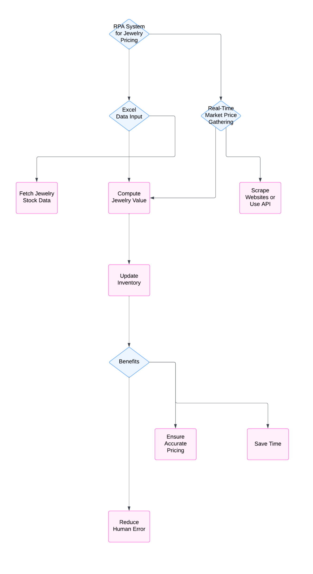
Architecture

Slide 7
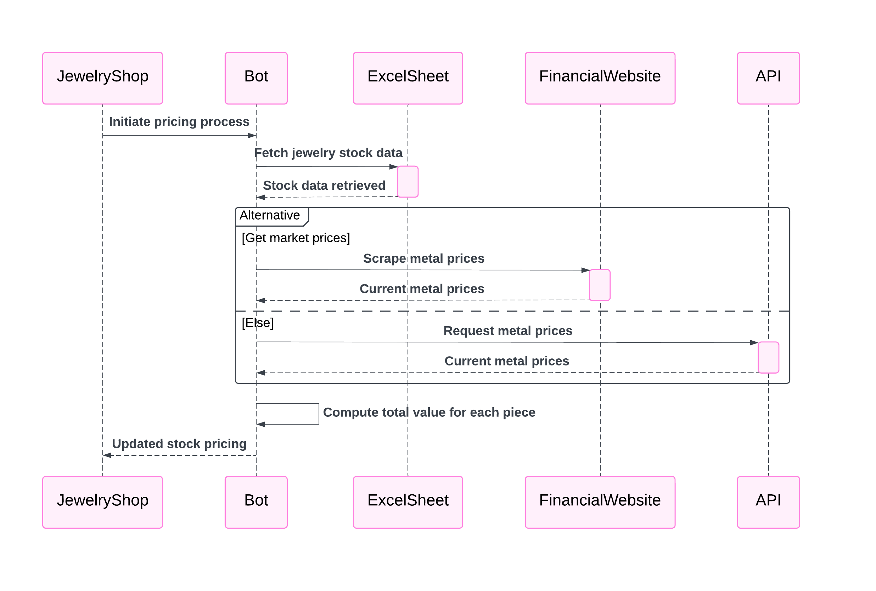
SEQUENCE DIAGRAM

Slide 8
System Requirements
Hardware Requirements:
To implement the Robotic Process Automation (RPA) system for the jewelry shop, the hardware must be robust enough to support continuous operation and data processing. Key hardware components include:
Processor: Intel Core i5 or higher (or equivalent AMD processor) to ensure efficient task handling and quick response times.
RAM: Minimum 8GB RAM for smooth execution of UiPath processes and handling multiple tasks simultaneously.
Storage: At least 256GB SSD or 500GB HDD to store Excel files, log files, and RPA-related data securely.
Internet Connection: A stable high-speed internet connection to facilitate real-time data retrieval from financial websites or APIs.
Monitor: Standard HD monitor for workflow design and monitoring.
Software Requirements:
The software stack is crucial for developing, deploying, and managing the RPA system:
Operating System: Windows 10 or later for compatibility with UiPath Studio and Orchestrator.
UiPath Studio: For designing and developing automation workflows.
UiPath Robot: To execute the automation processes.
UiPath Orchestrator (Optional): For managing and deploying bots centrally.
Microsoft Excel: For data handling and integration with Excel files.
Web Browser: Google Chrome or Microsoft Edge for web scraping.
API Integration Tools: To fetch real-time metal prices.

Slide 9
Functional Description
The proposed Robotic Process Automation (RPA) system aims to automate the pricing process for a jewelry shop by efficiently handling data extraction, processing, and computation. The system performs the following key functions:
Data Extraction:
The bot reads jewelry stock information from Excel sheets, including details such as jewelry type, weight, and current inventory. This is facilitated using UiPath's “Read Range” activity, converting the data into a structured DataTable format for further processing.
Real-Time Price Retrieval:
The bot fetches real-time market prices for gold and silver by scraping trusted financial websites or making API calls. This ensures that the latest and most accurate metal prices are always used in the calculations.
Price Calculation:
The bot computes the total value of each jewelry item by multiplying its weight with the corresponding real-time metal price. Any additional processing, such as applying taxes or discounts, can also be integrated into this step.
Data Update and Storage:
Once the pricing calculation is completed, the bot updates the Excel sheet with the calculated prices, storing them in a new column. This step ensures all data is up-to-date and readily accessible for the shop’s inventory management.

Slide 10
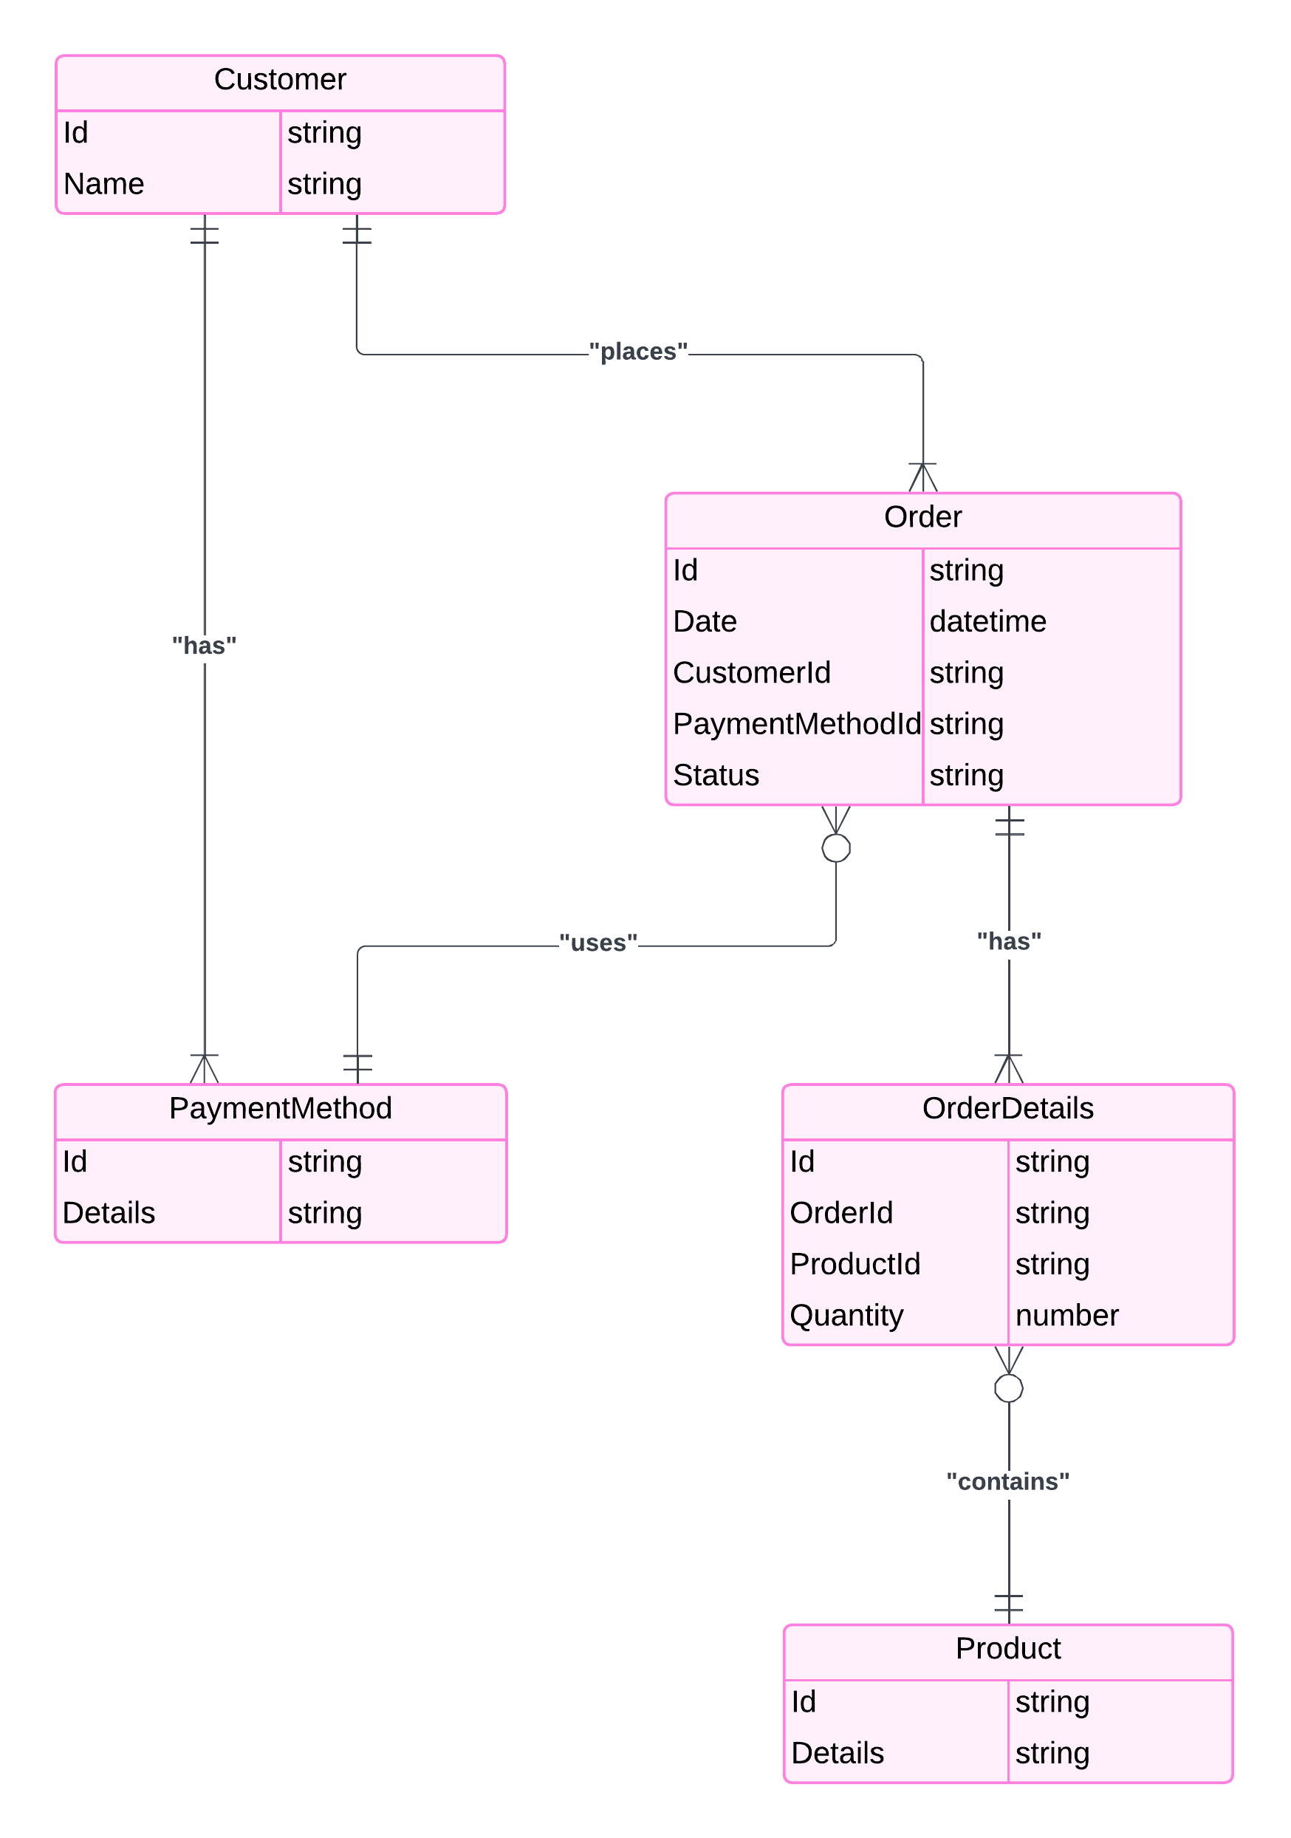
Table Design
ERD

Slide 11
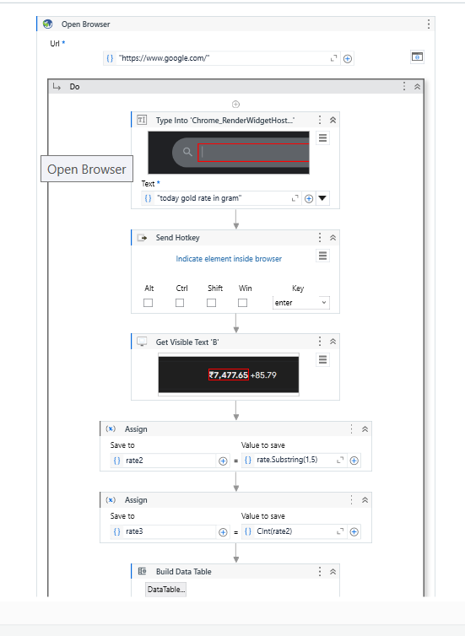
Implementation

Slide 12
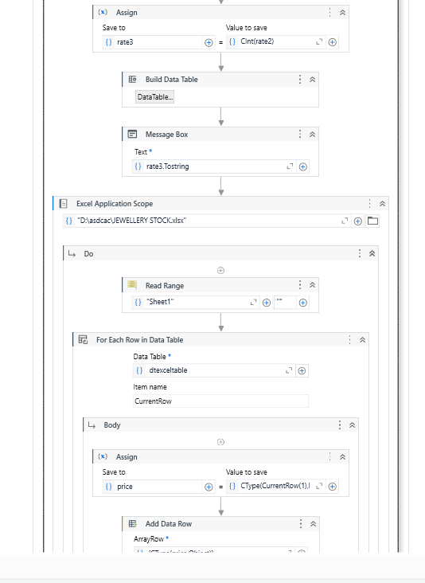
Implementation

Slide 13
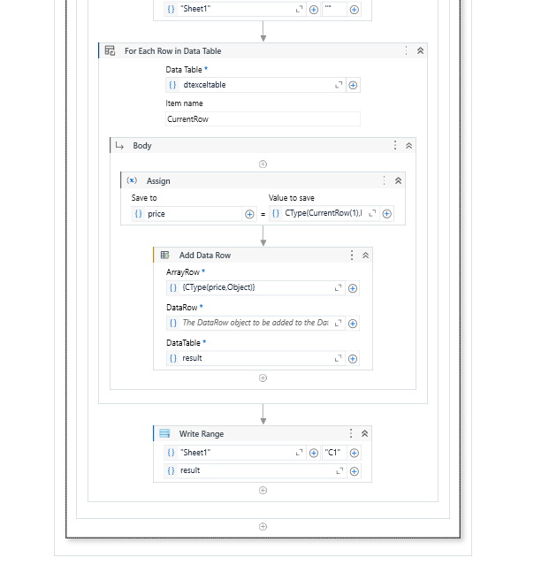
Implementation

Slide 14
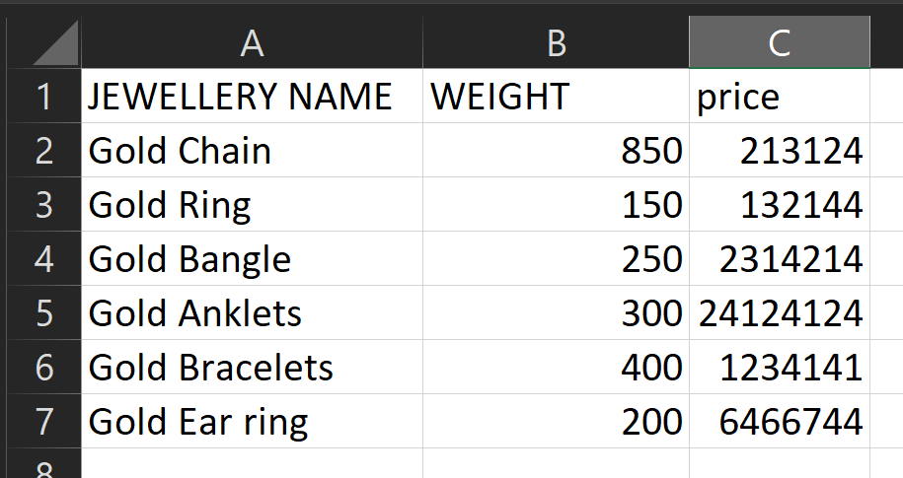
Testing

Slide 15
Conclusions
The implementation of Robotic Process Automation (RPA) in the jewelry shop's pricing process represents a transformative step towards efficiency and accuracy. By automating the retrieval of stock data from Excel sheets and integrating real-time metal prices through web scraping or APIs, the proposed system ensures that pricing calculations are consistent, reliable, and up-to-date. This reduces the dependency on manual intervention, minimizing human errors and streamlining operations.
The automation not only enhances operational efficiency but also allows staff to focus on higher-value tasks, improving overall productivity. The bot's ability to quickly adapt to market fluctuations ensures the shop remains competitive by offering accurate pricing at all times. Furthermore, the system's scalability allows it to handle growing data volumes as the business expands.
In conclusion, this RPA solution will modernize the pricing workflow, foster data accuracy, and boost customer satisfaction by ensuring transparent and trustworthy pricing.

Slide 16
Future Enhancement
Future enhancements for the RPA system in the jewelry shop could significantly expand its functionality and value. One key area of improvement is integrating advanced analytics and AI to predict market trends for gold and silver prices. This would allow the shop to anticipate price changes and adjust strategies proactively.
Another enhancement involves incorporating machine learning algorithms to identify customer buying patterns, enabling personalized pricing or promotional offers based on historical data. Enhancing the bot with natural language processing (NLP) capabilities could also allow it to handle customer inquiries or automate email responses related to pricing queries.
Expanding data sources to include global metal markets ensures comprehensive pricing accuracy. Integration with the shop’s inventory management system and CRM could provide a seamless flow of information across departments. Additionally, implementing a secure cloud-based solution would enable remote access and better scalability.
These enhancements would strengthen operational efficiency and provide the business with a competitive edge.

Slide 17
References
• van der Aalst, W. M. P., Bichler, M., & Heinzl, A. (2018). Robotic Process Automation. Business & Information Systems Engineering.
• Bukhari, S., Naqvi, I., & Khan, M. (2020). Real-Time Data Integration through RPA. Journal of Automation Technologies.
• Lu, Y., & Huang, X. (2019). Enhancing Inventory Management with Automation. Retail Innovation Journal.
• Willcocks, L. P., Lacity, M. C., & Craig, A. (2015). The Outsourcing Enterprise: RPA Trends. Global Automation Review.
• Hallikainen, P., Bekkhus, R., & Pan, S. L. (2018). Examining the Impact of Robotic Process Automation on Organizational Agility. Information Systems Frontiers.
• Aguirre, S., & Rodriguez, A. (2017). Automation Trends in Business Process Reengineering Using RPA. International Journal of Process Management.

Slide 18
Queries

Slide 19
Demonstration

Slide 20
Thank You

